Slide 1
Management of Intrauterine Fetal Demise
CCHS Grand Rounds
June 2018

Slide 2
Objectives
Describe the methods used in diagnosis of fetal demise
Discuss basic principles of management of fetal demise
Be able to offer local resources for bereavement management through our hospital system and in the community

Slide 3
Financial Disclosures
None
Off label medication use will be discussed and clarified as off-label during discussion

Slide 4
Patient presentation
Megan Bonds, MD

Slide 5
41 yo G5P3013 at approximately 40 weeks EGA
History:
Presented to L&D triage complaining of her “water broke.”
Brownish-red fluid, no odor
No prenatal care. Bleeding at 2 months, assumed miscarriage
Continued pregnancy realized 1-2 months later
No insurance, did not pursue prenatal care
Stopped feeling baby “kick” 2 months prior to presentation, though she thought did still feel some movements on the sides of her abdomen

Slide 6
PMH
No major medical issues
2 prior vaginal deliveries followed by 1 cesarean delivery, all at term
First vaginal delivery complicated by likely postpartum hemorrhage and uterine atony, requiring some type of sedation and surgical intervention*
No other surgeries
No alcohol, tobacco, or drug use
No allergies, no medications
*Patient delivered in another country; physician in charge spoke a different language than she did, and she does not know exactly what happened

Slide 7
Examination
41 yo gravid obese female, in some distress with contraction pain
Ultrasound demonstrated no fetal heart tones, fetus in vertex presentation with some edema around the head

Slide 8
Hospital course
Upon arrival of attending physician to confirm demise, patient was crowning with contractions
Underwent spontaneous vaginal delivery of non-viable female with spontaneous delivery of placenta
Mild continued bleeding following delivery
20 units IM Pitocin
0.2 mg IM methergine
Due to continued bleeding 1 hour later, re-exploration of lacerations performed, repaired, and bimanual massage confirmed LUS atony

Slide 9
Hospital course
Given 800 mcg of misoprostol PO, followed by 0.25 mg hemabate IM
Packing place in vagina to apply pressure to lacerations due to continued oozing
Labs obtained to rule out DIC

Slide 10
Hospital course
Hemostasis was confirmed
Labs were normal (no DIC)
Patient underwent routine postpartum course and was discharged
Bereavement care was provided

Slide 11
Pregnancy Loss and Intrauterine Fetal Demise
Cecily Collins, MD

Slide 12
Pregnancy Loss and Intrauterine Fetal Demise
Definitions
Epidemiology and Risk Factors
Diagnosis and Work-up
Management
First trimester
Second trimester
Third trimester
Special situations

Slide 13
Pregnancy loss
Abortion – loss of pregnancy prior to 20 weeks gestation
Spontaneous
Induced/therapeutic
Threatened
Inevitable/Incomplete
Missed
Fetal demise – loss of fetal cardiac activity
Can be abortion, pre-term, or term loss

Slide 14
Epidemiology – early pregnancy loss
Approximately 10% of all clinically recognized pregnancies
80% of these occur in the first trimester
Typically due to chromosomal anomalies
Frequency of early pregnancy loss:
9–17% between ages 20–30 years
20% at age 35 years
40% at age 40 years
80% at age 45 years

Slide 15
Epidemiology – Stillbirth
Stillbirth typically includes loss from 20 weeks on
6.2 births per 1000 births in 2004
Second trimester stillbirth – 3.2 per 1000
Rate is stable since 1990
Third trimester stillbirth – 3.1 per 1000
Rate decreasing since 1990 (previously 4.3 per 1000)

Slide 16
Risk factors
Non-Hispanic black
Nulliparity
Advanced maternal age
Obesity

Slide 17
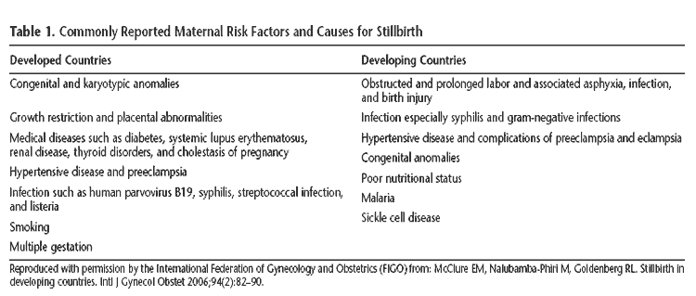

Slide 18
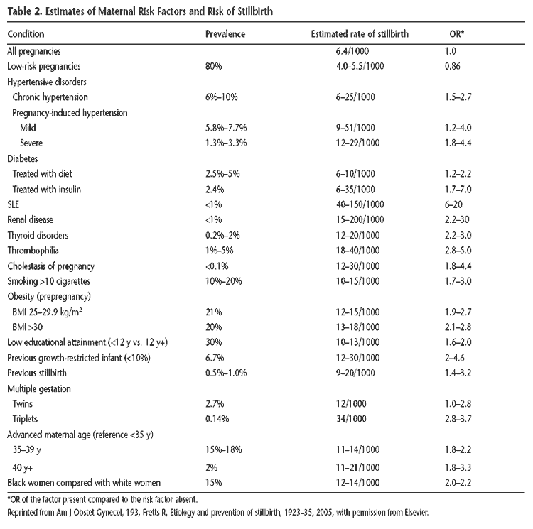

Slide 19
Diagnosis
Early pregnancy loss
Common symptoms – bleeding, cramping – NOT SPECIFIC
Serial ultrasonography
CRL of 7 mm without cardiac activity
Empty gest sac greater than 25 mm
Absence of embryo with FCA 2 weeks after initial scan showing gest sac
Absence of embryo with FCA 11 days after initial scan showing gest sac and yolk sac
Quantitative beta HCG
Used in conjunction with ultrasound findings
Typically less useful once intrauterine pregnancy is confirmed

Slide 20
Diagnosis
Stillbirth
Diagnosed prior to delivery with ultrasound showing no fetal cardiac activity
Diagnosed at delivery by a fetus/neonate which shows no signs of life
Absence of breathing, heart beat, pulsation of umbilical cord, or movement of voluntary muscles

Slide 21
Medical and Surgical Management
First trimester
Expectant management with frequent follow-up
Medical management
800 mcg misoprostol PV. Can repeat second dose between 3 hours and 7 days following initial dose
Rhogam if indicated
Mifepristone can be added if available
Surgical management
Dilation and suction curettage/evacuation
*Consider gestational age at time of demise with all options. If measuring greater than 10 weeks, surgical management more likely to be required
*use of misoprostol for pregnancy termination or cervical ripening is always an off-label but well studied use

Slide 22
Medical and Surgical Management
Second trimester
Dilation and evacuation/extraction
Labor induction
Vaginal misoprostol: 200-400 mcg q 4-12 hours
High dose oxytocin
Third trimester
Labor induction with usual protocols
Cesarean for unusual circumstances only
Monitoring for contractions is frequently done, but probably not necessary

Slide 23
Medical and Surgical Management
Special circumstances
Prior low-transverse cesarean
Can use transcervical balloon ripening, misoprostol (before 24-28 weeks), or high dose Pitocin
After 28 weeks, routine VBAC induction protocols are appropriate
Prior classical cesarean or fundal myomectomy
Individualize management based on patient factors

Slide 24
Management caveats
If patient is unstable (i.e. abruption or uterine rupture) should still proceed with cesarean delivery for maternal indications
Eclampsia is not an indication for immediate cesarean unless in status epilepticus
Pain control should be optimized
Consider short-term anxiolytics during the labor process
In the stable patient, delivery/surgery is not needed urgently – parents may be allowed time at home to process diagnosis if desires

Slide 25
Additional investigations
Inspection of fetus and placenta
Cytologic specimen collection
Amniotic fluid
Placental tissue from cord insertion
Segment of umbilical cord
Fetal tissue
Fetal autopsy (with consent)
Placental pathology

Slide 26
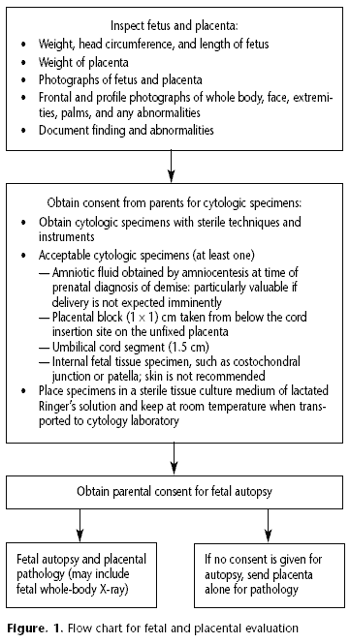

Slide 27
Additional investigations – at time of demise
Thorough history for maternal risk factors
Anti-phospholipid antibody workup
KB or other lab for fetal-maternal hemorrhage
Parvovirus b-19 IgG and IgM
Syphilis screen
TSH
Urine drug screen
Inherited thrombophilia work-up as appropriate

Slide 28
Additional investigations – postpartum
Protein C and S activity (if appropriate)
Parental karyotype (if appropriate)
Glucose tolerance (if LGA)
Indirect coombs

Slide 29
Emotional support
Consider religious interventions
Baptizing baby
Last Rites by a priest
Pastoral care for parents
Keepsakes/gifts
Footprints
Bracelet with name
Pictures
Mom keeps baby as long or for as little time as desired – no amount of time is the “right” or “wrong” length of time

Slide 30
Emotional support
Increased risk for post-partum depression – consider SSRI prior to discharge
Mother may want to donate milk – or may want help drying up milk
Pseudoephedrine (off-label use) does have side effect of decreasing milk supply
Cold compresses
Breast binding
Support groups, counseling
Many options available
http://www.tuscaloosadoulacoop.com/pregnancy--infant-loss-resources.html
Some in person, some online

Slide 32
Sources
“Management of Stillbirth.” ACOG Practice Bulletin Number 102. Mar 2009.
“Early Pregnancy Loss.” ACOG Practice Bulletin Number 150. May 2015, Reaffirmed 2017.
“Vaginal Birth after Cesarean Delivery.” ACOG Practice Bulletin Number 184. November 2017.
http://www.tuscaloosadoulacoop.com/pregnancy--infant-loss-resources.html

