Slide 1
Concussion:
The Hype, the Headlines, and the Hyperbole vs.
The Evidence
A Team Eye Doctor's Perspective
Katherine K. Weise, OD, MBA, FAAO
kweise@uab.edu
Mark Swanson, OD, MSPH, FAAO
Anne B. Sereno, PhD
Jennifer B. Christy, PT PhD
Graham D. Cochrane, MD, PhD

Slide 2
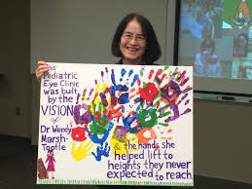
NIH Support - UAB Clinical Pediatric Optometry: 1997-present
UG1 – Drs. Katherine Weise (PI), Sarah Lee, M. Heath Hale
  Convergence Insufficiency Treatment Trial – Concussion (January 2016 to present)
U10– Drs. Kristine Hopkins (PI), Marcela Frazier, Sarah Lee, Wendy Marsh-Tootle, Katherine Weise
  Convergence Insufficiency Treatment Trial – Attention and Reading Trial (CITT-ART) (August 2014-present)
U10 - Pediatric Eye Disease Investigator Group (PEDIG) – Drs. Marcela Frazier (PI), Sarah Lee, Katherine Weise
(formerly Dr. Robert Rutstein, Dr. Wendy Marsh-Tootle)
  >100 Pediatric OMD and OD
  Executive Committee: Mayo, Duke, Johns Hopkins, SCCO, UABSO
  EY011751 (1997-present)
U10 – Dr. Wendy Marsh-Tootle (PI), Drs. Katherine Weise, Marcela Frazier, Lei Liu
  Correction of Myopia Evaluation Trial+ (COMET): 118/133 (89%) retention at year 14
  Multi-center Ocular Observations in Non-myopic Subjects (MOONS)
  EY11756, EY11754, EY11805, EY11752, EY11740, EY11755 (1998-2013)
RO1 – Dr. Wendy Marsh-Tootle (with T. Walls, MD)
  Multi-modal physician intervention to detect amblyopia
  R01 EY015893 (2005 to 2011)
U10 – Dr. Kristine Hopkins (PI), Drs. Marcela Frazier, Katherine Weise
  Convergence Insufficiency Treatment Trial
  EY014659-02 (2005-2011)
NIH Loan Repayment Program (mentor-sponsored research X 0.50 FTE)
  Dr. Wendy Marsh-Tootle, mentor
    Dr. Marcela Frazier (2005-2009)
    Dr. Katherine Weise (2003-2007)
    Dr. Sarah Lee (2013-present)

Slide 3

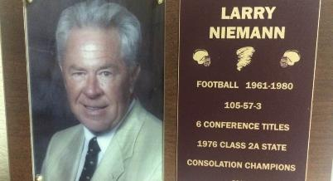
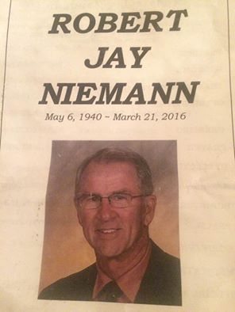
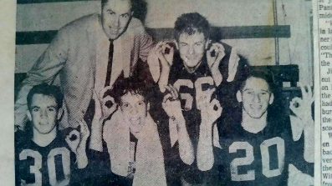
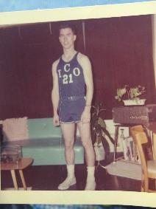
Robert J. Niemann, OD (ICO ‘63)
Coach Larry W. Niemann

Slide 4
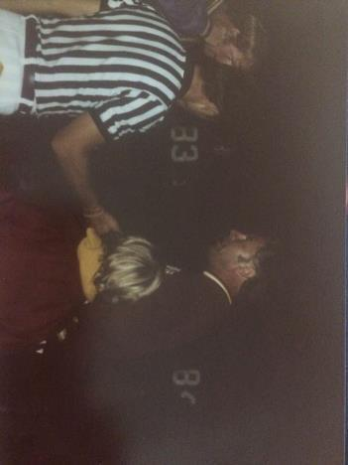
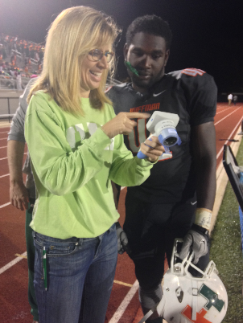
Katherine K. Weise, OD, MBA, FAAO

Slide 5
Concussion and Vision – Literature
2012-2013
Slowed, variable, and delayed dynamic vergence system
Photophobia (light senstivity)
Reduced near-point of convergence
  Szymanowicz D, Ciuffreda KJ, Thiagarajan P, Ludlam DP, Green W, Kapoor N. Vergence in mild traumatic brain injury: a pilot study. J Rehabil Res Dev. 2012;49(7):1083-100.
  Consistent accommodative fatigue effects
  Thiagarajan P, Ciuffreda KJ. Visual fatigue and accommodative dynamics in asymptomatic individuals. Optom Vis Sci. 2013 Jan;90(1):57-65.
  Perceived limited depth perception
  Ciuffreda KJ, Yadav NK, Han E, Ludlam DP, Peddle A, Hulse P, Walter S, Han J. Distance perception in mild traumatic brain injury (mTBI). Optometry. 2012 Apr 30;83(4):127-36.
  Photosensitivity
  Capó-Aponte JE, Urosevich TG, Temme LA, Tarbett AK, Sanghera NK. Visual dysfunctions and symptoms during the subacute stage of blast-induced mild traumatic brain injury. Mil Med. 2012 Jul;177(7):804-13.

Slide 6
Concussion Clinical Research Facility
Dream Team – July 2013
Children’s of Alabama
Marshall Crowther, MD – orthopedics
Drew Davis, MD - Pediatric Rehab Medicine
Leon S. Dure, MD – Pediatrics Neurology,
Drew Ferguson, MEd, ATC - UAB Sports Medicine Director
James M. Johnston, MD - Pediatric Neurosurgery
Eye and Vestibular
Claudio Busettini, PhD, Dr. Eng. – Vestibulo- ocular reflex science
Jennifer Christy, PT, PhD - Vestibular science
Chris Girkin, MD – Dept Chair, Opthalmology
Mark Swanson, OD, MS – Director, UAB Eye Care Ocular Disease Service
Katherine K. Weise, OD, MBA – Director, UAB Eye Care Pediatric and Binocular Vision Service
Neuroscience
Lori L. McMahon, PhD – Comprehensive Neuroscience Center
Athletics
Joseph Ackerson, PhD - Neuropsych, Chair for Alabama Statewide Sports Concussion Taskforce
Frank Messina, PhD - Asst Athletic Director, UAB
UAB Engineering and Biomedicine
Larry DeLucas, OD, PhD – Center for Biophysical Sciences and Engineering/NASA
Crawford Downs, PhD - Center for Ocular Biomechanics and Biotransport (COBB)
Cali Fidopiastis, PhD - Virtual Cognitive Rehabilitation
Dean Sicking, PhD – Helmet design/field analysis
Other Key Collaborators
Craig Formby, MA, PhD – UA(T) Communicative Disorders
Dennis Leonard – Legos of UAB
Marsha Snow, OD – VAMC
Candace Floyd, PhD –National Neurotrauma Society
Notes:
Other potential key centers:
Vision Science Center: Steven J. Pitler, PhD
Center for Free Radical Biology: Victor Darley-Usmar, PhD
Center for Study of Community Health: Max Michael, MD
Center for Clinical and Translational Science: Robert P. Kimberly, MD
Civitan International Research Center: Harald Sontheimer, PhD)

Slide 7
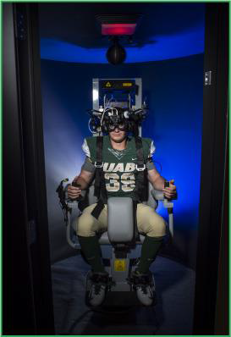
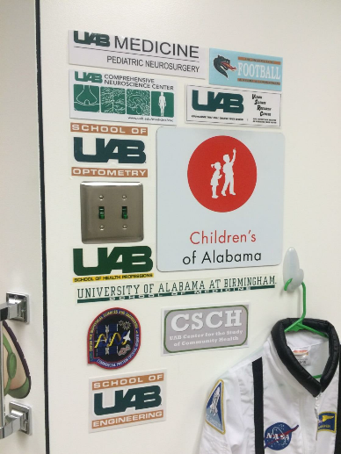
UAB/COA VORClinic 2014

Slide 8
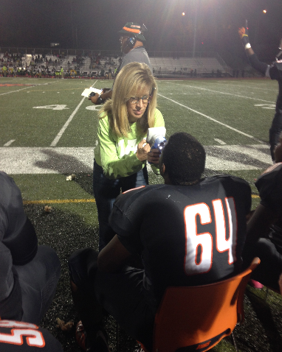
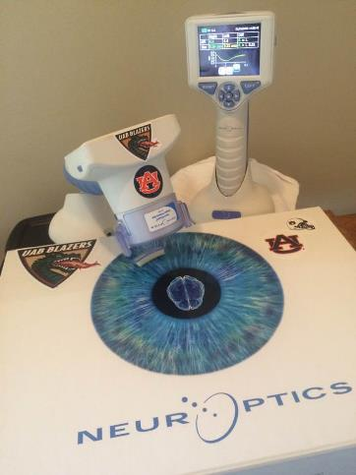
UAB/COA VORClinic UAB/COA VORClinic
2015 2016

Slide 9
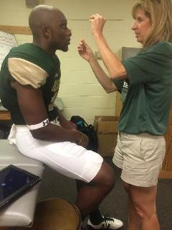
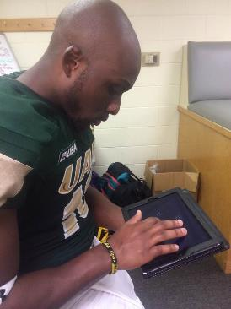
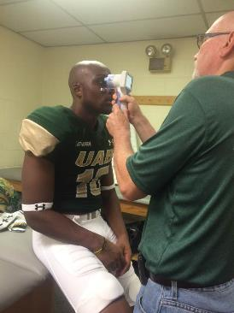
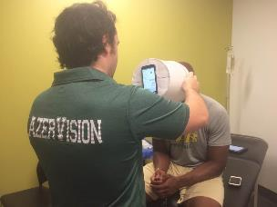

2017: Sidelines

Slide 10
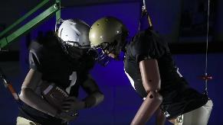
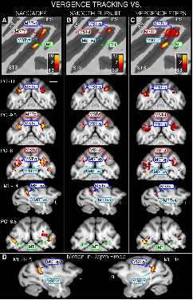
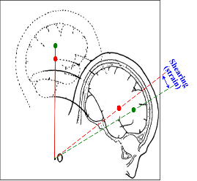
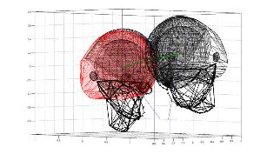
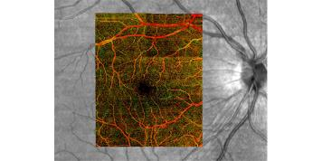
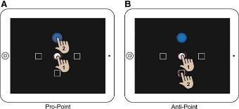
UAB/COA VORClinic 2018+

Slide 11
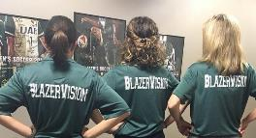
CEE/VEE 2017 – BlazerVision pilot year
26% of athletes tested never had an eye exam before
44% got better vision as a result of their BlazerVision comprehensive eye exam
100% of athletes tested thus far achieved best 3-D vision measurable
100% of athletes tested thus far achieved perfect vision, 20/20
65% of athletes tested thus far achieved better than perfect vision (20/15)

Slide 12

https://www.youtube.com/watch?v=cjzfYNTijUI

Slide 13
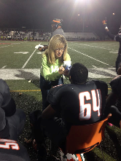


Concussion:
The Hype, the Headlines, and the Hyperbole vs. The Evidence
A Team Eye Doctor's Perspective
I. Concussion
II. Shaping the Research
  A. Why the Eye
  B. Objective Testing
  C. Predictors of Prolonged recovery
  D. Multi-system approach
III. Shaping the Future

Slide 14
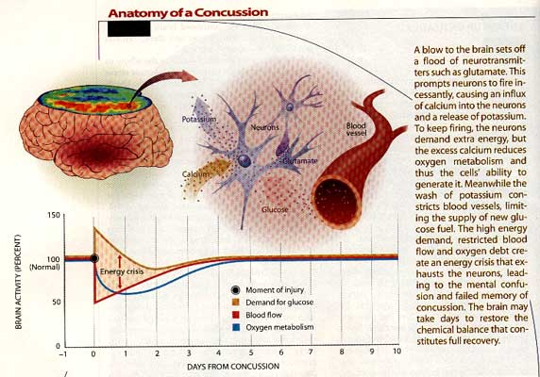
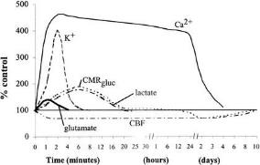
Metabolic Cascade Theory of Concussion
Concussion =
Interstate Crash

Slide 15
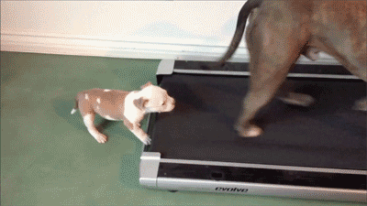
Metabolic Cascade Theory of Concussion:
Will the injured brain catch up with itself?

Slide 16
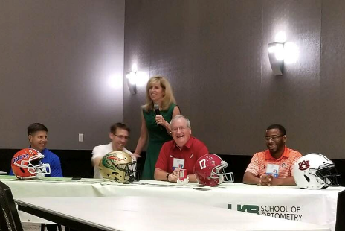
I. Shaping the Research:
How do we choose which tests are best?
M. Heath Hale, MD, MPH – UAB
Michael Goodlett, MD – AU
Jimmy Robinson, MD – UA
Joe Ackerson, PhD
  Chair, Statewide Concussion Taskforce
Notes:
Heath – I think we can beat concussion and I think it’s going to be through the eye.
Goodlett – I have a third, a third, a third. One third of my players are being honest with me, one third are being less than truthful because they want to get back into the game, and one third are being less than truthful to me because they don’t want to practice. And then Dr. GameDay shows up and all is suddenly well!
Robinson: If you could know 1 thing about concussion right now, what would it be? A way to predict who will be out for longer.
Sicking: Kathy, what is their concussion protocol is. How do they diagnosis it?

Slide 17

M. Heath Hale, MD, MPH:
“I think we can beat concussion and I think it’s going to be through the eye.”
NIH application January 2017:
Convergence Insufficiency in Concussion
  PI-Vision: K. Weise, OD, MBA
  PI-Concussion: M. Heath Hale, MD, MPH
Multi-center randomized control clinical trial
  Children’s of Philadelphia and Pennsylvania College of Optometry
  Children’s of Alabama and UAB School of Optometry
  Children’s of Orange County and So. California College of Optometry
  Akron Children’s
  Harvard University and Boston Children’s

Slide 18
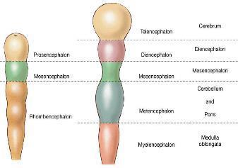
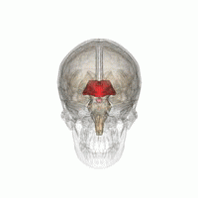
Why The Eye in Concussion?
It’s built from the brain.
Week 3 – 10 of pregnancy
Diencephalon (forebrain)
Forebrain
* * * * * * *
Midbrain
* * * * * * *
Hindbrain
Notes:
Eye formation in the human embryo begins at approximately 3 weeks into embryonic development and continues through the tenth week.[1] Cells from both the mesodermal and the ectodermal tissues contribute to the formation of the eye. Specifically, the eye is derived from the neuroepithelium, surface ectoderm, and the extracellular mesenchyme which consists of both the neural crest and mesoderm.[2] Neuroepithelium forms the retina, ciliary body, iris, and optic nerves. Surface ectoderm forms the lens, corneal epithelium and eyelid. The extracellular mesenchyme forms the sclera, cornea, blood vessels, muscles, and vitreous.
Chapter 15 - The Brain
Development of the Brain
The central nervous system (CNS) begins as a hollow neural tube with a fluid-filled internal cavity. In the fourth week of development the cephalic (head) portion of the tube expands to form three primary brain vesicles:
1. Prosencephalon – forebrain
2. Mesencephalon – midbrain
3. Rhombencephalon – hindbrain
As development proceeds, the prosencephalon divides into two new expanded portions called secondary brain vesicles:
a. Telencephalon – This portion develops into the cerebral hemispheres.
b. Diencephalon – This portion retains the name diencephalon and subdivides into the epithalamus, thalamus and hypothalamus. The eyes will also develop from optic vesicles that extend laterally from the diencephalons. The mesencephalon does not divide and is also called the midbrain. The rhombencephalon undergoes subdivision into the:
a. Metencephalon – The portion is next to the midbrain. The ventral portion of the metencephalon develops into the pons and the dorsal portion expands to form the cerebellum (“little cerebrum”). b. Myelencephalon – The portion closest to the spinal cord forms the medulla oblongata. The adult brain has 6 major landmarks: 1. cerebrum, 2. diencephalon, 3. mesencephalon, 4. pons, 5. cerebellum, 6. medulla oblongata. The mesencephalon, pons and medulla oblongata are often collectively referred to as the brainstem.

Slide 19
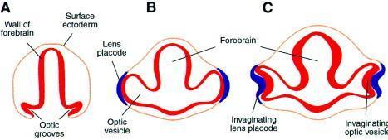
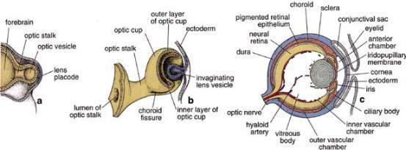
Why The Eye in Concussion?
It’s built From the brain.
Week 3 – 10 of pregnancy
Notes:
Eye formation in the human embryo begins at approximately 3 weeks into embryonic development and continues through the tenth week.[1] Cells from both the mesodermal and the ectodermal tissues contribute to the formation of the eye. Specifically, the eye is derived from the neuroepithelium, surface ectoderm, and the extracellular mesenchyme which consists of both the neural crest and mesoderm.[2] Neuroepithelium forms the retina, ciliary body, iris, and optic nerves. Surface ectoderm forms the lens, corneal epithelium and eyelid. The extracellular mesenchyme forms the sclera, cornea, blood vessels, muscles, and vitreous.
The eye begins to develop as a pair of optic vesicles on each side of the forebrain at the end of the 4th week of pregnancy. Optic vesicles are outgrowings of the brain which make contact with the surface ectoderm and this contact induces changes necessary for further development of the eye. Through a groove at the bottom of the optic vesicle known as choroid fissure the blood vessels enter the eye. Several layers such as the neural tube, neural crest, surface ectoderm, and mesoderm contribute to the development of the eye.[2]
The optic nerve is one of the 12 cranial nerves. The optic nerve is much more like the brain than any of the other 11 cranial nerves. Embryolgoically, it is an extension of the dienscephalon via the optic stalks during the 7th week of developemnt It is covered it myelin, unlike the other 11 cranial nerves that are covered in Schwan cells; Therefore, although it is grouped with 11 cranial nerves that are considiered part of the peripheral nervous system, it is really much more like the central nervous system. The optic nerve is made up of retinal axons from ganglion cells. Most of the axons or fibers go to the LGN and then to the visual cortext ot help us see. Some of the fibers to go the pretectum, which helps with pupil reflexes and also the hypothalmus, which helps with circadium rhythm. Many know htat people with concusion oftne have discrupted sleep-wake cycles and photophobial. There are researchers in optometry and neuro trying to determine the role of the eye in those symptoms. other reflexes help us keep our gaze steady. Some animals have a strong reflex that creates an eye moevment toward an object htat comes into the peripheral view. This is is an adaptive behavior that helps them get away from predators. We have a reflex that suppresses that sytem, but perhaps that it not working concussion. We are most interseted in the eye movements and the relfexes of the eye. One reflex is the VOR. Images still;
Embryologically and physiologically, the cranial nerve is more like the central nervous sytsem than the peripheral nervous system, like the other cranial nerves. It is a direct extension of the brain (from the diensephalon/optic stalks during embrylogical development. The optic nerve runs to 9 primary visual nuclei in the brain including the superior colliculus, which is important in orienting the movements of head and eyes.

Slide 20
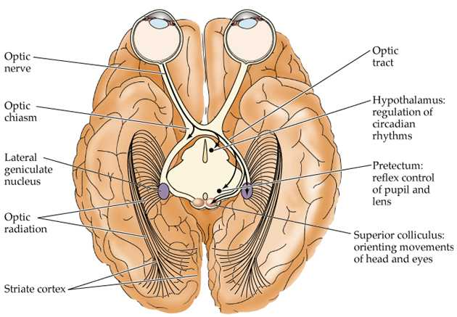
Why the Eye in Concussion?
It courses Through the brain.
Notes:
Central projections of retinal ganglion cells. Ganglion cell axons terminate in the lateral geniculate nucleus of the thalamus, the superior colliculus, the pretectum, and the hypothalamus.
The lateral geniculate nucleus (LGN) is the primary processing center for visual information received from the retina of the eye. The LGN is found inside the thalamus of the brain, and is thus part of the central nervous system.
The LGN receives information directly from the ascending retinal ganglion cells via the optic tract and from the reticular activating system. Neurons of the LGN send their axons through the optic radiation, a pathway directly to the primary visual cortex (or V1), also known as the striate cortex. The primary visual cortex surrounds the calcarine fissure, a horizontal fissure in the medial and posterior occipital lobe.^{[1]} In addition, the LGN receives many strong feedback connections from the primary visual cortex. In mammals and humans the two strongest pathways linking the eye to the brain are those projecting to the LGNd (dorsal part of the LGN in the thalamus), and to the Superior Colliculus (SC)^{[2]}
Process of Visual Input in the Retina
Within the retina, certain features of visual input are enhanced while other features may be discarded. This is because there are only 1million ganglion cells but 126 million photoreceptors.
Once receptors in rods and cones receives message, the message is spread through the synaptic terminals of vision neurons. Everything that can be seen by one eye is that eye’s visual field. Because our eyes are located anteriorly in the head, the visual field of the two eyes overlap considerably. We have binocular vision due to the large region where the visual fields of the two eyes overlap. The visual field of each eye is divided into two regions. Moreover, visual information from the right half of each visual field is conveyed to the left side of the brain, where as visual information from the left half of each visual field is conveyed to the right side of the brain.
(ref: http://www.arn.org/docs/glicksman/120104%20fig3.jpg)
Axons of all retinal ganglion cells in one eye exit the eyeball at the optic disc and form the optic nerve on that side.
At the optic chiasm, axons from the temporal half of each retinal do not cross but continue directly to the thalamus on the same side.
In contrast, axons from the nasal half of each retina cross and continue to the opposite thalamus.
Axon branches of the retinal ganglion cells project to the mid brain, where they participate in circuits that govern constrictions of pupils in response to light and co-ordination of head and eye movements. Hypothalamus also establishes the patterns of sleep and other activities that occur on a daily schedule in response to intervals of light and darkness.
The axons of thalamic neurons form the optic radiation as they project from the thalamus to the primary visual area of the cortex on the same side.

Slide 21
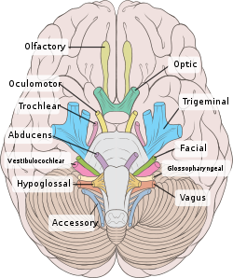
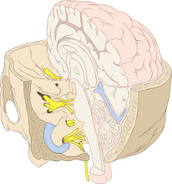
Why the Eye?
Cranial Nerves
  I - Olfactory
  II - Optic
  III - Oculomotor
  IV - Trochlear
  V - Trigeminal
  VI - Abducens
  VII - Facial
  VIII - Vestibulocochlear
  IX - Glossopharyngeal
  X - Vagus
  XI - Accessory
  XII - Hypoglossal
Notes:
Not just the optic nerve that relates the eye to the brain. 7 of the 12 cranial nerves have something to do with the eye. The way the cranial nerves course through the brain, if a hit is rotational, there may be axonal damage within these 7 cranial nerves. May affectretinal integrity (2), eye movements (3, 4, 6) and VOR (8).

Slide 22

Why The Eye in Concussion?
The Eye
  is built from the brain,
  is built like the brain,
  courses through the brain.

Slide 23
Concussion and Vision
Objective visual electrodiagnostic testing affected in concussion reported as early as 1976.
  Feinsod M, 1976
  Freed S, 1997
Studies of standard clinical optometry testing between 1999-2017 repeatedly show vision issues related to concussion.
Notes:
Two Articles on vision and concussion relationship between ‘76-’97

Slide 24
Concussion and Vision in Children
Prevalence Studies: Signs
Study | N | Ave. age | Study Design | Conv Insuff | Accomm Insuff | Eye Tracking | Visual Field | Specialty if not Eye Care
Master C Scheiman M 2016 | 100 | 14.5 | pro | 49% | 51% | 29%
Pearce KL 2015 | 78 | 14 | pro | 42% |  |  |  | Ortho
Stelmack 2009 | 103 |  | retro | 28% | 47% | 6% | 14%
Brahm 2009 | 191 |  | retro | 42% | 42% | 33% | 32%
Goodrich 2007 | 50 |  | retro | 30% | 22% | 20% | 21% | Psychology
Suchoff 1999 | 62 | 19-70 |  | 42% | 10% | 40% | 32%
Normal population |  |  |  | BV = 5% | 3% | 2%
Notes:
Compared to the normal population, BV findings in concussion are common; research showing visual conditions in children with concussion are consistently reported.
Eye care professionals are authors unless noted; not just eye care people noticing these changes. Confirmed by other disciplines as well.
Scheiman paper is similar to study we are doing at COA/UAB Optometry; this study was done at our “sister institution” (at least in concussion): CHoP and Salus University, Pennsylvania School of Optometry
.

Slide 25
Vision rarely mentioned in
Concussion Position Statements
Consensus statement on concussion in sport: the 4th International Conference on Concussion in Sport, Zurich, November 2012.
  McCrory P, Meeuwisse WH, Aubry M, Cantu RC, Dvořák J, Echemendia RJ, Engebretsen L, Johnston K, Kutcher JS, Raftery M, Sills A, Benson BW, Davis GA, Ellenbogen R, Guskiewicz KM, Herring SA, Iverson GL, Jordan BD, Kissick J, McCrea M, McIntosh AS, Maddocks D, Makdissi M, Purcell L, Putukian M, Schneider K, Tator CH, Turner M.
  J Athl Train. 2013 Jul-Aug;48(4):554-75.
  Future study necessary: KD and reaction time
Sport-related concussion: Evaluation and management
  Laura K Purcell, Canadian Paediatric Society, Healthy Active Living and Sports Medicine Committee
  Paediatr Child Health. 2014 Mar; 19(3): 153–158.
  Candian Pediatric Society Paediatr Child Health
American Academy of Pediatrics. Clinical report--sport-related concussion in children and adolescents.
  Halstead ME, Walter KD; Council on Sports Medicine and Fitness.
  Pediatrics. 2010 Sep;126(3):597-615
American Medical Society for Sports Medicine position statement: concussion in sport.
Harmon KG, Drezner J, Gammons M, Guskiewicz K, Halstead M, Herring S, Kutcher J, Pana A, Putukian M, Roberts W; American Medical Society for Sports Medicine.
Clin J Sport Med. 2013 Jan;23(1):1-18.

Slide 26
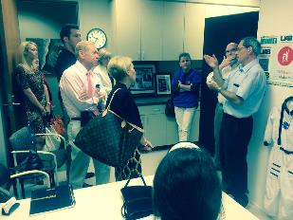
  2014 National Athletic Trainers’ Position statement
    Consider: smooth pursuits, nystagmus, pupil reflex; (CN testing)
    No convergence, accommodation, eye tracking recommended
    Broglio SP, Cantu RC, Giolia GA, Guskiewicz KM, Kutcher J, Palm M, Valovich McLeod TC, National Athletic Trainer’s Association. National Athletic Trainer’s Association position statement: management of sport concussion. J Athl Train 2014;49:245-65.
  2015: Current and emerging rehabilitation for concussion: a review of the evidence.
    Broglio SP, Collins MW, Williams RM, Mucha A, Kontos AP.
    Clin Sports Med. 2015 Apr;34(2):213-31. doi: 10.1016/j.csm.2014.12.005.
                Vision Therapy
                Ciuffreda, Scheiman
                CI/AI/saccades, etc.
Notes:
However, despite growing evidence that also non-vestibular oculomotor vision tasks, including convergence, accommodation, saccadic transfers of gaze, and smooth-pursuit tracking are affected in a majority of children.¹⁹⁻²⁴ and that children with convergence insufficiency have greater total symptom scores,²⁴ vision is rarely mentioned in return-to-learn protocols.^{11,25-27} Just over one third of responding athletic trainers from the NCAA reported testing Snellen visual acuity and fewer than 5% reported testing saccadic eye movements with King-Devick.¹² The 2014 National Athletic Trainers’ Position Statement recommended testing smooth pursuits, nystagmus, and pupil reflex and did not include convergence and accommodation testing, or comprehensive eye tracking assessments evaluations in the recommended assessment protocols.²⁸
Halstead ME, Walter KD, Council on Sports Medicine and Fitness. American Academy of Pediatrics. Clinical report—sport-related concussion in children and adolescents. Pediatrics 2010;126:597-615.
Olympia RP, Ritter JT, Brady J, Bramley H. Return to learning after a concussion and compliance with recommendations for cognitive rest. Clin J Sport Med 2015; [epub ahead of print]
Purcell LK, Canadian Pediatric Society, Healthy Active Living and Sports Medicine Committee. Sport-related concussion: evaluation and management. Paediatr Child Health 2014;19:153-8.
DeMatteo C, Stazyk K, Giglia L, Mahoney W, Singh SK, Hollenberg R, Harper JA, Missiuna C, Law M, McCauley D, et al. A balanced protocol for return to school for children and youth following concussive injury. Clin Pediatr (Phila) 2015;54:783-92.

Slide 27
Berlin 2016 – the new Zurich
1) Neuropsychological testing
  Cornerstone of sports-related concussion management
  NP are uniquely qualified to contribute to a multi-disciplinary approach
  Cognitive recovery often overlaps with clinical symptom recovery, but may also precede or lag behind
  NP testing should remain an important component of sports-related concussion recovery and in particular return-to-learn decisions.
  HOWEVER,
    NP testing should NOT be the sole basis of management decisions
    It should be used in a range of clinical assessments of different clinical domains
      Mental status, cognition, oculomotor function (!), gross sensorimotor, coordination, gait, vestibular function, and balance.

Slide 28
Concussion and Vision in Children
Prevalence Studies: Signs
Study | N | Ave. age | Study Design | Conv Insuff | Accomm Insuff | Eye Tracking | Visual Field | Specialty if not Eye Care
Master C Scheiman M 2016 | 100 | 14.5 | pro | 49% | 51% | 29%
Pearce KL 2015 | 78 | 14 | pro | 42% |  |  |  | Ortho
Stelmack 2009 | 103 |  | retro | 28% | 47% | 6% | 14%
Brahm 2009 | 191 |  | retro | 42% | 42% | 33% | 32%
Goodrich 2007 | 50 |  | retro | 30% | 22% | 20% | 21% | Psychology
Suchoff 1999 | 62 | 19-70 |  | 42% | 10% | 40% | 32%
Normal population |  |  |  | BV = 5% | 3% | 2%
Notes:
Compared to the normal population, BV findings in concussion are common; research showing visual conditions in children with concussion are consistently reported.
Eye care professionals are authors unless noted; not just eye care people noticing these changes. Confirmed by other disciplines as well.
Scheiman paper is similar to study we are doing at COA/UAB Optometry; this study was done at our “sister institution” (at least in concussion): CHoP and Salus University, Pennsylvania School of Optometry
.

Slide 29
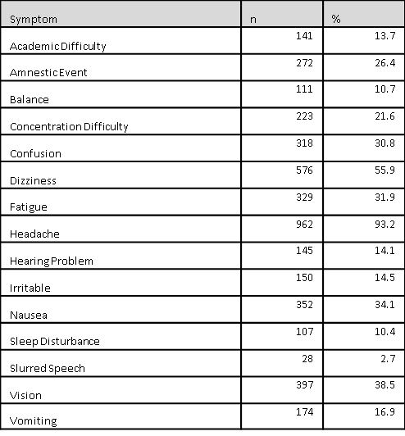
3
SYMPTOMS OF
MILD TBI –
Children’s of Alabama
Concussion Database
M. Swanson, et al. 2015
1
2
Notes:
Second paper: When you do a regression analysis on these symptoms, the symptom that remains correlated with academic difficulty is vision (not headaches, not balance, not sleep disturbances).
and was supported by the UAB Department of Optomeand was supported by the UAB Department of Optometry and the UAB Vision Science Research Center’s National Institutes of Health P30 EY003039 core grant. try and the UAB Vision Science Research Center’s National Institutes of Health P30 EY003039 core grant.

Slide 30
COA REDCap Database: 2007-2013
Swanson M, et al, 2016
Swanson M, Weise KK, Dreer LE, Johnston J, Davis RD, Ferguson D, Hale MH, Gould SJ, Swanson E, Christy JC, Busettini C, Lee SD.
Cross-sectional study
N = 1,033 (2007-2013)
  Cohort of interest (N = 276)
    5 to 18 years
    > 3 symptoms
    > 10 days of concussion-related symptoms (self-report)
Notes:
N = 1033 kids aged 5 to 18, 276 with 3 or more symptoms
Data were obtained from the Children’s of Alabama Concussion Clinic REDCap dataset from the period January
2007 to October 2013. From this dataset of 1033 concussion events, a cohort of 276 children aged 5 to 18 years with three
or more concussion-related symptoms present for 10 days or more was identified. A cross-sectional cohort study was
undertaken to evaluate the association of concussion symptoms, SCAT2 scores, and demographic and concussion severity
markers to reported educational difficulty among children with prolonged post-concussive symptoms. Univariate and
multivariate logistic regression techniques were used to model the association of reported educational difficulty to selfreported
vision abnormalities.
Results. Mean age was 13.8 years. Median time since the concussive event was 21 days, with 33% (95/276) reporting their
concussion more than 30 days before data collection. Academic difficulty was reported by 29% (79/270) and vision abnormalities
in 46% (128/274). After model reduction, vision symptoms (OR 2.17, 95% CI 1.02, 4.62), hearing disturbance
(OR 2.39, 95% CI 1.06, 5.36), and concentration difficulty (OR 21.62, 95% CI 9.50, 44.47) remained associated with
academic difficulty. For those with symptoms 30 days or more after concussion, only vision (OR 3.15, 95% CI 1.06, 9.38)
and concentration difficulty (OR 15.33, 95% CI 4.99, 47.05) remained statistically significant.
Conclusions. Vision problems were commonly reported in children with concussions and were independently associated
with those reporting academic difficulty. Comprehensive vision assessment should be considered in children reporting
academic difficulty and in the development of return-to-learn protocols.

Slide 31
COA REDCap Database: 2007-2013
Swanson M, et al, 2016
N = 276 Concussed, Symptomatic >3) kids > 10 days out
  Age
  Days since concussion
  Race
  Gender
  Insurance (Private vs. Public)
  Number of Previous Concussions
  Loss of consciousness
  Event Amnesia
  Imaging
  SCAT
  Balance Difficulty
  Concentration Difficulty
  Confusion
  Dizziness
  Fatigue
  Headache
  Hearing
  Irritable
  Nausea
  Sleep disturbance
  Slurred speech
  Vision
  Vomiting
  Education Difficulty
Notes:
N = 1033 kids aged 5 to 18, 276 with 3 or more symptoms

Slide 32
COA REDCap Database: 2007-2013
Swanson M, et al, 2016
N = 276 Concussed, Symptomatic >3) kids > 10 days out
29% (79/270) reported Academic Difficulty
46% (128/274) reported Vision Abnormalities
  >30 days (33%): Only vision and concentration remained statistically significantly associated with academic difficulty

Slide 33
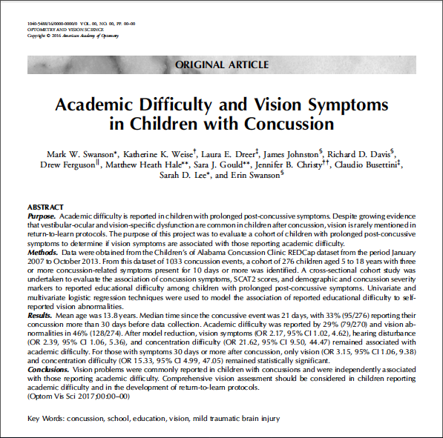
Optometry and Vision Science
http://www.optvissci.com

Slide 34
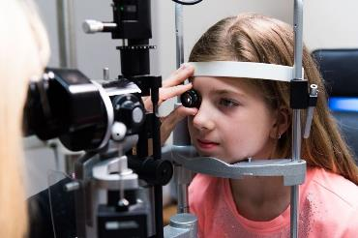
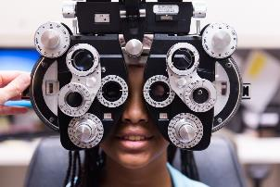

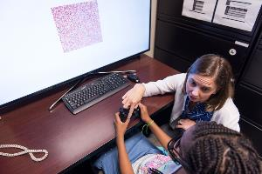
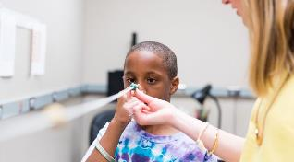
1. The eye is affected in concussion.
2. How can we use the eye to tell us about the brain in concussion?

Slide 35


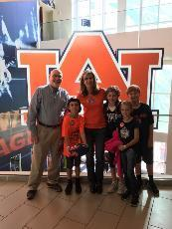
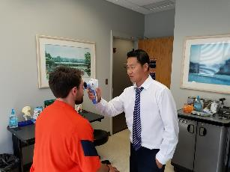
Michael Goodlett, MD:
“I got a third, a third, a third. A third of my players are being honest, a third are being less than truthful because they want to play and a third are being less than truthful because they don’t want to practice.”
Identifies a need for objective testing

Slide 36
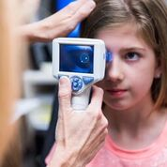

UAB/COA Pupillometer under
Friday Night Lights
Average NPi: Pre-Season
(n = 600+)
  4.1 + 0.30
  Clinical Setting
    COA clinical exam room or
    High school gymnasium
    (vs. Friday night lights)

Slide 37
UAB/COA Pre-season Sports Physicals Spring 2015 - Pupillometer
N = 247 in one high school
Average NPi (from NeurOptics, Inc.)
  4.1 + 0.32
Average NPi (from UAB/COA)
  4.1 + 0.30
Bland-Altman Limits of Agreement (UAB/COA)
  LOA (OD) = 0.49; LOA (OS) = 0.48
  Repeat if two measures differ by 0.50 or more
  A measure that is 0.50 different post concussion is a true difference

Slide 38
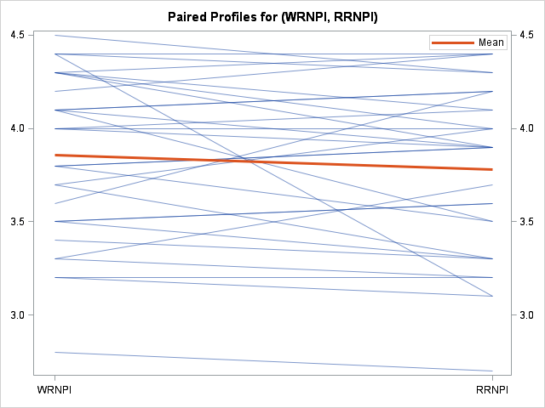
UAB/COA Pupillometer under
Friday Night Lights: RE vs. RE (repeatability)

Slide 39
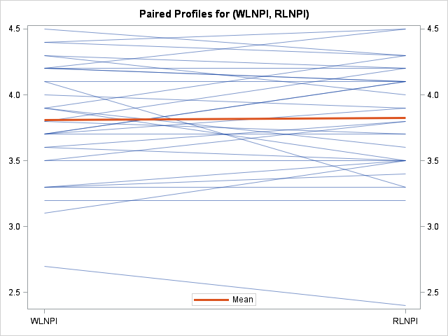
UAB/COA Pupillometer under
Friday Night Lights: LE vs. RE (consistency)

Slide 40
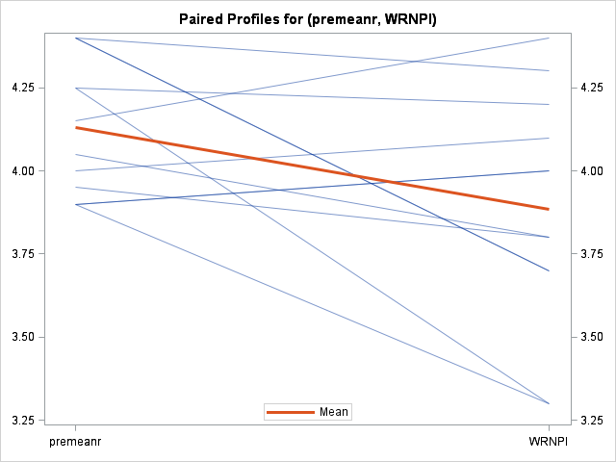
UAB/COA Pupillometer under
Friday Night Lights: Pre-season vs. sidelines (RE)
P=.05

Slide 41
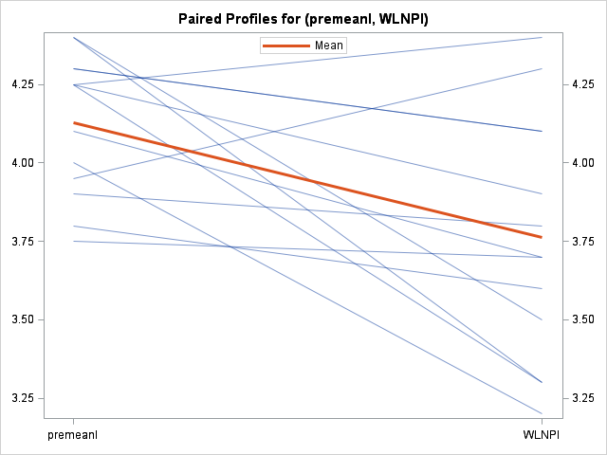
UAB/COA Pupillometer under
Friday Night Lights: Pre-season vs. sidelines (LE)
P=.01

Slide 42

Pupillometery Post Concussion?

Slide 43
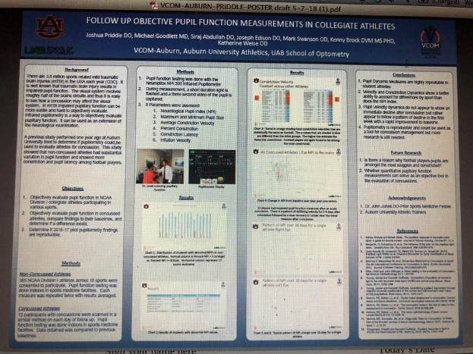
Award Winning Presentation: Auburn-UAB
Follow-up Objective Pupil Function in Concussed Athletes
J. Priddle, DO; M. Swanson, OD, MPSH et al
American Osteopathic Academy of Sports Medicine 2018

Slide 44
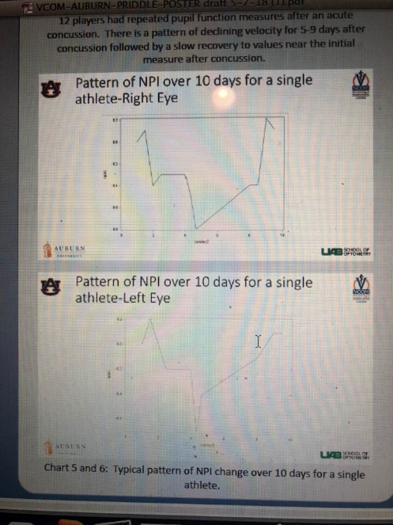

Slide 45
Metabolic Cascade Theory of Concussion:
Will the injured brain catch up with itself?

Slide 46

Jimmy Robinson, MD:
If you could know 1 thing about concussion right now, what would it be?
“A way to predict who will be out longer.”
Identifies a need for measurable predictors of recovery and return to learn/play

Slide 47
A. The Problem: 2000-2016:
Typical short-term recovery
Most symptoms of sports-related concussion are transient
    Browne GJ, Br J Sports Med, 2006
1 week recovery in 90% of high school athletes
  Symptoms recover to baseline within 1 week after sports-related concussion in 90%
    Guskiewicz KM, J Athl Train, 2001 Guskiewicz KM, JAMA, 2003
    Iverson GL, Brain Inj, 2006 McCrea M, JAMA 2003
    McCrory P, 2009
Notes:
90% are transient: Browne GJ, Lam LT: Concussive head injury in children and
adolescents related to sports and other leisure physical activities.
Br J Sports Med 40:163–168, 2006
Resolve within 1 week:
Guskiewicz KM, McCrea M, Marshall SW, Cantu RC, Randolph
C, Barr W, et al: Cumulative effects associated with
recurrent concussion in collegiate football players: the NCAA
Concussion Study. JAMA 290:2549–2555, 2003
24. Guskiewicz KM, Ross SE, Marshall SW: Postural stability
and neuropsychological deficits after concussion in collegiate
athletes. J Athl Train 36:263–273, 2001
30. Iverson GL, Brooks BL, Collins MW, Lovell MR: Tracking
neuropsychological recovery following concussion in sport.
Brain Inj 20:245–252, 2006
42. McCrea M, Barr WB, Guskiewicz K, Randolph C, Marshall
SW, Cantu R, et al: Standard regression-based methods for
measuring recovery after sport-related concussion. J Int
Neuropsychol Soc 11:58–69, 2005
44. McCrea M, Guskiewicz KM, Marshall SW, Barr W, Randolph C, Cantu RC, et al: Acute effects and recovery time following
concussion in collegiate football players: the NCAA
Concussion Study. JAMA 290:2556–2563, 2003
46. McCrory P, Meeuwisse W, Johnston K, Dvorak J, Aubry
M, Molloy M, et al: Consensus statement on Concussion
in Sport—the 3rd International Conference on Concussion
in Sport held in Zurich, November 2008. J Sci Med Sport
12:340–351, 2009

Slide 48

Prolonged Recovery Characteristics
Corwin DJ, Zonfrillo MR, Master CL
J Pediatr 2014;165:1207-15
N = 247 patients age 5 to 18 years with concussion
Median
  Return to Part-Time School: 12 days
  Return to School without accommodations: 35 days
  Symptom Free: 64 days
  Return to Play (cleared for sports): 75 days
Notes:
Characteristics of Prolonged Concussion Recovery in a Pediatric
Subspecialty Referral Population
Daniel J. Corwin, MD1, Mark R. Zonfrillo, MD, MSCE1,2,3,4, Christina L. Master, MD4,5, Kristy B. Arbogast, PhD1,2,4,
Matthew F. Grady, MD4,5, Roni L. Robinson, MSN, CRNP5, Arlene M. Goodman, MD5, and Douglas J. Wiebe, PhD3,4
Objective To identify pre-existing characteristics associated with prolonged recovery from concussion in a sample
of patients referred to a pediatric sports medicine clinic.
Study design This was a retrospective, exploratory cohort study of 247 patients age 5-18 years with concussion
referred to a tertiary pediatric hospital-affiliated sports medicine clinic from July 1, 2010, through December 31,
2011. A random sample of all eligible patient visits (3740) was chosen for further review and abstraction. Statistical
comparisons between subsets of patients were conducted using exact c2 tests, logistic regression, quantile regression,
and Kaplan-Meier survival curves.
Results The median time until returning to school part-time was 12 days (IQR 6-21); until returning to
school full-time without accommodations was 35 days (IQR 11-105); until becoming symptom-free was
64 days (IQR 18-119); and until being fully cleared to return to sports was 75 days (IQR 30-153). Furthermore,
73% of all patients were symptomatic for >4 weeks, 73% were prescribed some form of school
accommodation, and 61% reported a decline in grades. Characteristics associated with a prolonged recovery
included a history of depression or anxiety; an initial complaint of dizziness; abnormal convergence or
symptom provocation following oculomotor examination on physical examination; and history of prior
concussion.
Conclusions Pediatric and adolescent patients with concussion may experience cognitive and emotional
morbidity that can last for several months following injury. Clinicians should consider specific pre-existing characteristics
and presenting symptoms that may be associated with a more complicated recovery for concussion
patients. (J Pediatr 2014;165:1207-15).

Slide 49
Berlin 2016 – the new Zurich
5) Further research needed to distinguish how a child is different than an adult in concussion
  Normal clinical recovery
    Adults: >10-14 days
    Child: > 4 weeks
  In other words, “7 to 10 days” for a child’s expected recovery from a concussion is officially outdated.
Notes:
Brief computerised cognitive evaluation tools are a commonly utilised component of these assessments worldwide given the logistical limitation in accessing trained neuropsychologists. However, it should be noted that these are not substitutes for complete NP assessment. Baseline or pre-season NP testing was considered by the panel and was not felt to be required as a mandatory aspect of every assessment; however, it may be helpful or add useful information to the overall interpretation of these tests. It also provides an additional educative opportunity for the healthcare provider to discuss the significance of this injury with the athlete.
We recommend that child and adolescent guidelines refer to individuals 18 years or less. Child-specific paradigms for SRC should apply to children aged 5–12 years, and adolescent-specific paradigms should apply to those aged 13–18 years. The literature does not adequately address the question of age groups in which children with SRC should be managed differently from adults. No studies have addressed whether SRC signs and symptoms differ from adults. The expected duration of symptoms in children with SRC is up to 4 weeks, and further research is required to identify predictors of prolonged recovery. It is recommended that age-specific validated symptom-rating scales be used in SRC assessment, and further research is required to establish the role and utility of computerised NP testing in this age group. Similar to adults, a brief period of physical and cognitive rest is advised after SRC followed by symptom-limited resumption of activity. Schools are encouraged to have an SRC policy that include
Refer
Persistent symptoms
A standard definition for persistent post-concussive symptoms is
needed to ensure consistency in clinical management and research
outcomes. The Berlin expert consensus is that use of the term
‘persistent symptoms’ following SRC should reflect failure of
normal clinical recovery—that is, symptoms that persist beyond
expected time frames (ie, >10–14 days in adults and >4 weeks
in children).
‘Persistent

Slide 50
Predictors of Prolonged Recovery
Event Amnesia
  (Joe Ackerson, PhD)
  Teel EF, Marshall SW, Shanker V, McCrea M, Guskiewicz KM, 2017
    Predicting Recovery Patterns After Sports-Related Concussion
  7 sports at 26 colleges and 210 high schools
  N = 8905 college, 7513 high school athletes
  N = 375 concussions
    Hour 3, then Day 1, 2, 3, 5, 7, and 90
Notes:
(how did you get off the field? Who was next to you on the field? What was the score? Who were you playing?)
Predicting Recovery Patterns After Sport-Related Concussion.
Teel EF1, Marshall SW2,3, Shankar V4, McCrea M, Guskiewicz KM1,2.
Author information
1
Matthew Gfeller Sport-Related Traumatic Brain Injury Research Center, Department of Exercise and Sport Science, and Curriculum in Human Movement Science, Department of Allied Health Sciences, School of Medicine.
2
Injury Prevention Research Center, and.
3
Department of Epidemiology, The University of North Carolina at Chapel Hill.
4
Department of Epidemiology and Population Health, Albert Einstein College of Medicine, Bronx, NY.
Abstract
CONTEXT:
Clinicians sometimes treat concussed individuals who have amnesia, loss of consciousness (LOC), a concussion history, or certain symptom types more conservatively, but it is unclear whether recovery patterns differ in individuals with these characteristics.
OBJECTIVE:
To determine whether (1) amnesia, LOC, and concussion history influence the acute recovery of symptoms, cognition, and balance; and (2) cognition and balance are influenced by acute symptom type.
DESIGN:
Cohort study.
SETTING:
Seven sports at 26 colleges and 210 high schools.
PATIENTS OR OTHER PARTICIPANTS:
A total of 8905 collegiate (n = 1392) and high school (n = 7513) athletes.
MAIN OUTCOME MEASURE(S):
The Graded Symptom Checklist, Standardized Assessment of Concussion, and Balance Error Scoring System were administered to all athletes during the preseason. To allow us to track recovery patterns, athletes diagnosed with a concussion (n = 375) repeated these assessments immediately after the injury, 3 hours postinjury, 1 day postinjury, and at 2, 3, 5, 7, and 90 days after injury.
RESULTS:
Athletes who experienced amnesia had markedly greater deficits in and a slower recovery trajectory on measures of symptoms, cognition, and balance. Athletes with 2 or more prior concussions demonstrated poorer balance than those with no previous history. Otherwise, LOC and concussion history largely did not affect symptoms, cognition, or balance. Greater deficits in balance scores were observed in athletes with all symptom types. Regardless of these characteristics, most athletes recovered within 7 to 10 days.
CONCLUSIONS:
Athletes who experienced amnesia had more symptoms and greater deficits in cognition and balance. Symptoms and cognitive or balance deficits were not consistently associated with LOC or concussion history. Acute symptoms had a strong influence on balance scores and, to a lesser extent, on cognition. However, we found no evidence to support more cautious return-to-play decisions for athletes with these characteristics, as group recovery occurred within normal timelines. Our study supports current clinical practice: recommending that athletes be withheld from activity until they are asymptomatic, followed by a graduated return-to-play progression.
KEYWORDS:
Balance Error Scoring System; Standardized Assessment of Concussion; return to play; traumatic brain injuries
PMID: 28387552 PMCID: PMC5384825 [Available on 2018-03-01] DOI: 10.4085/1062-6050-52.1.12

Slide 51
Predictors of Prolonged Recovery
Pyschological factors
  Van der Naalt J, 2017 (Lancet Neurol)
    Early predictors of outcome after mild traumatic brain injury (UPFRONT): an observational cohort study.
  N = 910 emergency department patients
    in ED,
    2 weeks,
    6 months
  Emotional distress, maladaptive coping
  Pre-injury mental health problems, education, age
Notes:
Lancet Neurol. 2017 Jul;16(7):532-540. doi: 10.1016/S1474-4422(17)30117-5. Epub 2017 Jun 13.
Early predictors of outcome after mild traumatic brain injury (UPFRONT): an observational cohort study.
van der Naalt J1, Timmerman ME2, de Koning ME3, van der Horn HJ3, Scheenen ME4, Jacobs B3, Hageman G5, Yilmaz T6, Roks G6, Spikman JM7.
Author information
1
Department of Neurology, University of Groningen, University Medical Center Groningen, Groningen, Netherlands. Electronic address: j.van.der.naalt@umcg.nl.
2
Department of Psychometrics and Statistics, University of Groningen, University Medical Center Groningen, Groningen, Netherlands.
3
Department of Neurology, University of Groningen, University Medical Center Groningen, Groningen, Netherlands.
4
Department of Clinical Neuropsychology, University of Groningen, University Medical Center Groningen, Groningen, Netherlands.
5
Department of Neurology, Hospital Medisch Spectrum Twente Enschede, Enschede, Netherlands.
6
Department of Neurology, Elisabeth Hospital Tilburg, Tilburg, Netherlands.
7
Department of Neurology, University of Groningen, University Medical Center Groningen, Groningen, Netherlands; Department of Clinical Neuropsychology, University of Groningen, University Medical Center Groningen, Groningen, Netherlands.
Abstract
BACKGROUND:
Mild traumatic brain injury (mTBI) accounts for most cases of TBI, and many patients show incomplete long-term functional recovery. We aimed to create a prognostic model for functional outcome by combining demographics, injury severity, and psychological factors to identify patients at risk for incomplete recovery at 6 months. In particular, we investigated additional indicators of emotional distress and coping style at 2 weeks above early predictors measured at the emergency department.
METHODS:
The UPFRONT study was an observational cohort study done at the emergency departments of three level-1 trauma centres in the Netherlands, which included patients with mTBI, defined by a Glasgow Coma Scale score of 13-15 and either post-traumatic amnesia lasting less than 24 h or loss of consciousness for less than 30 min. Emergency department predictors were measured either on admission with mTBI-comprising injury severity (GCS score, post-traumatic amnesia, and CT abnormalities), demographics (age, gender, educational level, pre-injury mental health, and previous brain injury), and physical conditions (alcohol use on the day of injury, neck pain, headache, nausea, dizziness)-or at 2 weeks, when we obtained data on mood (Hospital Anxiety and Depression Scale), emotional distress (Impact of Event Scale), coping (Utrecht Coping List), and post-traumatic complaints. The functional outcome was recovery, assessed at 6 months after injury with the Glasgow Outcome Scale Extended (GOSE). We dichotomised recovery into complete (GOSE=8) and incomplete (GOSE≤7) recovery. We used logistic regression analyses to assess the predictive value of patient information collected at the time of admission to an emergency department (eg, demographics, injury severity) alone, and combined with predictors of outcome collected at 2 weeks after injury (eg, emotional distress and coping).
FINDINGS:
Between Jan 25, 2013, and Jan 6, 2015, data from 910 patients with mTBI were collected 2 weeks after injury; the final date for 6-month follow-up was July 6, 2015. Of these patients, 764 (84%) had post-traumatic complaints and 414 (45%) showed emotional distress. At 6 months after injury, outcome data were available for 671 patients; complete recovery (GOSE=8) was observed in 373 (56%) patients and incomplete recovery (GOSE ≤7) in 298 (44%) patients. Logistic regression analyses identified several predictors for 6-month outcome, including education and age, with a clear surplus value of indicators of emotional distress and coping obtained at 2 weeks (area under the curve [AUC]=0·79, optimism 0·02; Nagelkerke R2=0·32, optimism 0·05) than only emergency department predictors at the time of admission (AUC=0·72, optimism 0·03; Nagelkerke R2=0·19, optimism 0·05).
INTERPRETATION:
Psychological factors (ie, emotional distress and maladaptive coping experienced early after injury) in combination with pre-injury mental health problems, education, and age are important predictors for recovery at 6 months following mTBI. These findings provide targets for early interventions to improve outcome in a subgroup of patients at risk of incomplete recovery from mTBI, and warrant validation.
FUNDING:
Dutch Brain Foundation.
Copyright © 2017 Elsevier Ltd. All rights reserved.
PMID: 28653646 DOI: 10.1016/S1474-4422(17)30117-5

Slide 52
Predictors of Prolonged Recovery
Iverson GL 2017 (Br J Sports Med)
  Predictors of clinical recovery from concussion: a systematic review.
N = 101 articles
The most consistent predictor of slower recovery:
  Acute and subacute symptoms
  Headache
  Depression
  Mental health
  Teenage years?
But Wait!
Notes:
We need more measurable measures!
X160401011
Br J Sports Med. 2017 Jun;51(12):941-948. doi: 10.1136/bjsports-2017-097729.
Predictors of clinical recovery from concussion: a systematic review.
Iverson GL1,2, Gardner AJ3, Terry DP1,2, Ponsford JL4, Sills AK5, Broshek DK6, Solomon GS7.
Author information
Abstract
OBJECTIVE:
A systematic review of factors that might be associated with, or influence, clinical recovery from sport-related concussion. Clinical recovery was defined functionally as a return to normal activities, including school and sports, following injury.
DESIGN:
Systematic review.
DATA SOURCES:
PubMed, PsycINFO, MEDLINE, CINAHL, Cochrane Library, EMBASE, SPORTDiscus, Scopus and Web of Science.
ELIGIBILITY CRITERIA FOR SELECTING STUDIES:
Studies published by June of 2016 that addressed clinical recovery from concussion.
RESULTS:
A total of 7617 articles were identified using the search strategy, and 101 articles were included. There are major methodological differences across the studies. Many different clinical outcomes were measured, such as symptoms, cognition, balance, return to school and return to sports, although symptom outcomes were the most frequently measured. The most consistent predictor of slower recovery from concussion is the severity of a person's acute and subacute symptoms. The development of subacute problems with headaches or depression is likely a risk factor for persistent symptoms lasting greater than a month. Those with a preinjury history of mental health problems appear to be at greater risk for having persistent symptoms. Those with attention deficit hyperactivity disorder (ADHD) or learning disabilities do not appear to be at substantially greater risk. There is some evidence that the teenage years, particularly high school, might be the most vulnerable time period for having persistent symptoms-with greater risk for girls than boys.
CONCLUSION:
The literature on clinical recovery from sport-related concussion has grown dramatically, is mostly mixed, but some factors have emerged as being related to outcome.
© Article author(s) (or their employer(s) unless otherwise stated in the text of the article) 2017. All rights reserved. No commercial use is permitted unless otherwise expressly granted.
KEYWORDS:
Concussion; age; moderators; outcome; sex differences; sports
PMID: 28566342 DOI: 10.1136/bjsports-2017-097729

Slide 53

Jimmy Robinson, MD:
If you could know 1 thing about concussion right now, what would it be?
“A way to predict who will be out longer.”
Identifies a need for measurable predictors of recovery and return to learn/play

Slide 54

Predictors of Prolonged Recovery
NPC?!
DuPrey, May 2017 (Am J Sports Med)
  Convergence Insufficiency Identifies Athletes at Risk of Prolonged Recovery From Sport-Related Concussion
N = 270 athletes age 10-21
NPC > 6 cm = abnormal
Notes:
Am J Sports Med. 2017 May 1:363546517705640. doi: 10.1177/0363546517705640. [Epub ahead of print]
Convergence Insufficiency Identifies Athletes at Risk of Prolonged Recovery From Sport-Related Concussion.
DuPrey KM1, Webner D1, Lyons A2, Kucuk CH3, Ellis JT1, Cronholm PF2,4.
Author information
1
Department of Sports Medicine, Crozer-Keystone Health System, Springfield, Pennsylvania, USA.
2
Department of Family and Community Health, Center for Public Health Initiatives, University of Pennsylvania, Philadelphia, Pennsylvania, USA.
3
Philadelphia College of Osteopathic Medicine, Philadelphia, Pennsylvania, USA.
4
Leonard Davis Institute of Health Economics, University of Pennsylvania, Philadelphia, Pennsylvania, USA.
Abstract
BACKGROUND:
Sensitive and specific screening methods are needed to identify athletes at risk of prolonged recovery after sport-related concussion (SRC). Convergence insufficiency (CI) is a common finding in concussed athletes.
PURPOSE:
To assess the relationship between CI and recovery after SRC at the initial office visit.
STUDY DESIGN:
Case-control study; Level of evidence, 3.
METHODS:
In this retrospective cohort study, 270 athletes (147 male, 123 female), mean ± SD age 14.7 ± 2.0 years (range, 10-21 years), with the diagnosis of SRC who presented for initial office visit between January 2014 and January 2016 were evaluated for near point of convergence (NPC). The athletes were categorized into 2 groups: normal near point of convergence (NPC ≤6 cm), and convergence insufficiency (NPC >6 cm). These athletes were then followed to determine recovery time.
RESULTS:
Athletes presented for initial office visit at a mean of 5.2 ± 4.2 days (range, 1-21 days) after SRC. Half of the athletes had CI after SRC (50.4%; n = 136). Athletes with CI (NPC 12.3 ± 4.7 cm) took significantly longer to recover after SRC, requiring 51.6 ± 53.9 days, compared with athletes with normal NPC (4.1 ± 1.3 cm), who required 19.2 ± 14.7 days ( P < .001). After controlling for potential confounding variables, CI significantly increased the odds of prolonged recovery (≥28 days from injury) by 12.3-fold ( P < .001; 95% confidence interval, 6.6-23.0). CI screening correctly classified 75.2% of our sample with 84.2% sensitivity and 70.0% specificity. The positive predictive value for CI and prolonged recovery was 62.5%, and the negative predictive value was 88.1%.
CONCLUSION:
CI at the initial office visit identified athletes at increased risk of prolonged recovery after SCR. Clinicians should consider measuring NPC in concussed athletes as a quick and inexpensive prognostic screening method.
KEYWORDS:
clinical assessment/grading scales; eye injuries; head injuries/concussion; pediatric sports medicine
PMID: 28511593 DOI: 10.1177/0363546517705640

Slide 55
Predictors of Prolonged Recovery
DuPrey, May 2017 (Am J Sports Med)
  Convergence Insufficiency Identifies Athletes at Risk of Prolonged Recovery From Sport-Related Concussion
50.4% had receded NPC (n = 136)
  Recovery = 51.6 days vs. 19.2 days (p < 0.001)
  Odds of prolonged recovery increased by 12.3 fold (p < 0.001 ) in convergence insufficiency
Notes:
Am J Sports Med. 2017 May 1:363546517705640. doi: 10.1177/0363546517705640. [Epub ahead of print]
Convergence Insufficiency Identifies Athletes at Risk of Prolonged Recovery From Sport-Related Concussion.
DuPrey KM1, Webner D1, Lyons A2, Kucuk CH3, Ellis JT1, Cronholm PF2,4.
Author information
1
Department of Sports Medicine, Crozer-Keystone Health System, Springfield, Pennsylvania, USA.
2
Department of Family and Community Health, Center for Public Health Initiatives, University of Pennsylvania, Philadelphia, Pennsylvania, USA.
3
Philadelphia College of Osteopathic Medicine, Philadelphia, Pennsylvania, USA.
4
Leonard Davis Institute of Health Economics, University of Pennsylvania, Philadelphia, Pennsylvania, USA.
Abstract
BACKGROUND:
Sensitive and specific screening methods are needed to identify athletes at risk of prolonged recovery after sport-related concussion (SRC). Convergence insufficiency (CI) is a common finding in concussed athletes.
PURPOSE:
To assess the relationship between CI and recovery after SRC at the initial office visit.
STUDY DESIGN:
Case-control study; Level of evidence, 3.
METHODS:
In this retrospective cohort study, 270 athletes (147 male, 123 female), mean ± SD age 14.7 ± 2.0 years (range, 10-21 years), with the diagnosis of SRC who presented for initial office visit between January 2014 and January 2016 were evaluated for near point of convergence (NPC). The athletes were categorized into 2 groups: normal near point of convergence (NPC ≤6 cm), and convergence insufficiency (NPC >6 cm). These athletes were then followed to determine recovery time.
RESULTS:
Athletes presented for initial office visit at a mean of 5.2 ± 4.2 days (range, 1-21 days) after SRC. Half of the athletes had CI after SRC (50.4%; n = 136). Athletes with CI (NPC 12.3 ± 4.7 cm) took significantly longer to recover after SRC, requiring 51.6 ± 53.9 days, compared with athletes with normal NPC (4.1 ± 1.3 cm), who required 19.2 ± 14.7 days ( P < .001). After controlling for potential confounding variables, CI significantly increased the odds of prolonged recovery (≥28 days from injury) by 12.3-fold ( P < .001; 95% confidence interval, 6.6-23.0). CI screening correctly classified 75.2% of our sample with 84.2% sensitivity and 70.0% specificity. The positive predictive value for CI and prolonged recovery was 62.5%, and the negative predictive value was 88.1%.
CONCLUSION:
CI at the initial office visit identified athletes at increased risk of prolonged recovery after SCR. Clinicians should consider measuring NPC in concussed athletes as a quick and inexpensive prognostic screening method.
KEYWORDS:
clinical assessment/grading scales; eye injuries; head injuries/concussion; pediatric sports medicine
PMID: 28511593 DOI: 10.1177/0363546517705640

Slide 56
Near Point of Convergence After Sport-Related Concussion: Measurement of Reliability and Relationship to Neurocognitive Impairment and Symptoms (Pearce KL, Dec. 2015)
1Department of Orthopaedic Surgery, University of Pittsburgh, Pittsburgh, Pennsylvania, USA.
2Department of Orthopaedic Surgery, University of California, San Francisco, San Francisco, California, USA.
3Department of Orthopaedic Surgery, University of Pittsburgh, Pittsburgh, Pennsylvania, USA akontos@pitt.edu
“CONCLUSION:
CI was common (~42%) in athletes evaluated within 1 month after an SRC. Athletes with CI had worse neurocognitive impairment and higher symptom scores than did those with normal NPC. Clinicians should consider routinely screening for NPC as part of a comprehensive concussion evaluation to help inform treatment recommendations, academic accommodations, and referrals for vision therapy.”
Notes:
Am J Sports Med. 2015 Dec;43(12):3055-61. doi: 10.1177/0363546515606430. Epub 2015 Oct 9.
Near Point of Convergence After a Sport-Related Concussion: Measurement Reliability and Relationship to Neurocognitive Impairment and Symptoms.
Pearce KL1, Sufrinko A1, Lau BC2, Henry L1, Collins MW1, Kontos AP3.
Author information
1Department of Orthopaedic Surgery, University of Pittsburgh, Pittsburgh, Pennsylvania, USA.
2Department of Orthopaedic Surgery, University of California, San Francisco, San Francisco, California, USA.
3Department of Orthopaedic Surgery, University of Pittsburgh, Pittsburgh, Pennsylvania, USA akontos@pitt.edu.
Abstract
BACKGROUND:
Convergence insufficiency (CI) is a common binocular vision deficit after a sport-related concussion (SRC). CI may result in visual discomfort and vision-mediated functional difficulties such as slowed reading and compromised attention, leading to impaired academic, work, and sport performance.
PURPOSE:
To test the reliability of repeated near point of convergence (NPC) measurements in a sample of athletes after an SRC; compare the symptoms and cognitive impairment of athletes with normal NPC to those with CI after an SRC; and explore the relationship among age, sex, learning disability, migraine history, and CI.
STUDY DESIGN:
Cross-sectional study; Level of evidence, 3.
METHODS:
A total of 78 athletes (mean age, 14.31 ± 2.77 years) who were seen a mean 5.79 ± 5.63 days after an SRC were administered 3 trials of an NPC assessment, along with neurocognitive (Immediate Post-Concussion Assessment and Cognitive Testing [ImPACT]) and symptom assessments. Patients were divided into normal NPC (NPC ≤5 cm; n = 45) and CI (NPC >5 cm; n = 33) groups. Intraclass correlation coefficients (ICCs) and repeated-measures analyses of variance (ANOVAs) assessed the consistency of NPC across the 3 trials. The ANOVAs were employed to examine differences on neurocognitive composites and symptoms between the normal NPC and CI groups. Stepwise regressions (controlling for age and symptom scores on the Post-Concussion Symptom Scale [PCSS]) were conducted to evaluate the predictive utility of the NPC distance for neurocognitive impairment.
RESULTS:
Groups did not differ on demographic or injury characteristics. NPC differed between trial 1 and trials 2 (P = .02) and 3 (P = .01) for the CI group but not the normal NPC group. Internal consistency was high across NPC measurements (ICC range, 0.95-0.98). Patients with CI performed worse on verbal memory (P = .02), visual motor speed (P = .02), and reaction time (P = .001, η(2) = .13) and had greater total symptom scores (P = .02) after the injury. Results of hierarchical regression revealed that the NPC distance contributed significantly to the model for reaction time (P < .001).
CONCLUSION:
CI was common (~42%) in athletes evaluated within 1 month after an SRC. Athletes with CI had worse neurocognitive impairment and higher symptom scores than did those with normal NPC. Clinicians should consider routinely screening for NPC as part of a comprehensiveconcussion evaluation to help inform treatment recommendations, academic accommodations, and referrals for vision therapy.

Slide 57
Int J Sports Med. 2016 May;37(5):405-10. doi: 10.1055/s-0035-1569290. Epub 2016 Feb 9.
Effect of Repetitive Sub-concussive Head Impacts on Ocular Near Point of Convergence.
Kawata K, Tierney R, Phillips J, Jeka JJ.
Abstract
This study intended to examine effects of repetitive sub-concussive head impacts on ocular near point of convergence (NPC). 20 healthy young adult soccer players were assigned to either a heading or control group. Heading subjects completed 10 headers of soccer balls projected at a speed of 11.2 m/s. Control subjects did not perform heading. Linear head acceleration was measured with a triaxial accelerometer. The NPC assessment was performed at pre-, 0 h post-, and 24 h post-heading. During the NPC assessment participants were seated and a visual target was moved towards the eyes at 1cm/sec. The participant signaled when he/she experienced diplopia or deviation of the eye was observed, and the distance was recorded. The assessment was repeated twice and average NPC scores were used for further analysis. Soccer heading induced mean group head accelerations of 14.49±5.4 g. Mild head impacts led to an increased NPC distance, which was supported by a significant Group x Time interaction. In the heading group, 0 h post- and 24 h post-heading NPC scores were significantly receded compared to baseline. Conversely, NPC scores for the control group showed no difference over time. Our findings indicate that mild frontal head impacts affect NPC for a minimum of 24 h-post heading, suggesting that oculomotor processes are disrupted, at least transiently, by repetitive mild head impact.
Notes:
nt J Sports Med. 2016 May;37(5):405-10. doi: 10.1055/s-0035-1569290. Epub 2016 Feb 9.
Effect of Repetitive Sub-concussive Head Impacts on Ocular Near Point of Convergence.
Kawata K1, Tierney R1, Phillips J1, Jeka JJ1.
Author information
1
Kinesiology, Temple University, Philadelphia, United States.
Abstract
This study intended to examine effects of repetitive sub-concussive head impacts on ocular near point of convergence (NPC). 20 healthy young adult soccer players were assigned to either a heading or control group. Heading subjects completed 10 headers of soccer balls projected at a speed of 11.2 m/s. Control subjects did not perform heading. Linear head acceleration was measured with a triaxial accelerometer. The NPC assessment was performed at pre-, 0 h post-, and 24 h post-heading. During the NPC assessment participants were seated and a visual target was moved towards the eyes at 1cm/sec. The participant signaled when he/she experienced diplopia or deviation of the eye was observed, and the distance was recorded. The assessment was repeated twice and average NPC scores were used for further analysis. Soccer heading induced mean group head accelerations of 14.49±5.4 g. Mild head impacts led to an increased NPC distance, which was supported by a significant Group x Time interaction. In the heading group, 0 h post- and 24 h post-heading NPC scores were significantly receded compared to baseline. Conversely, NPC scores for the control group showed no difference over time. Our findings indicate that mild frontal head impacts affekt NPC for a minimum of 24 h-post heading, suggesting that oculomotor processes are disrupted, at least transiently, by repetitive mild head impact.
© Georg Thieme Verlag KG Stuttgart · New York.
PMID: 26859643 DOI: 10.1055/s-0035-1569290
[Indexed for MEDLINE]

Slide 58

Convergence Insufficiency Treatment Trial
(non-concussed kids) 2005-2009
Pennsylvania College of Optometry (25)
  PI: Mitch Scheiman, OD
Bascom Palmer Eye Institute (35)
SUNY College of Optometry (28)
UAB School of Optometry (28)
  Kristine Hopkins, OD, MSPH (Local PI)
  Kathy Weise, OD, MBA (back up PI)
NOVA Southeastern University (27)
The Ohio State University College of Optometry (24)
Southern California College of Optometry (23)
University of CA San Diego: Ratner Children's Eye Center (17)
Mayo Clinic (14)
National Eye Institute, Bethesda, MD: Paivi Miskala, PhD.
Data and Safety Monitoring Committee
n = 221

Slide 59

Convergence Insufficiency Treatment Trial
N = 221
Age: 9 to 17 years
RCT:
  Office-based vision therapy (12 weeks) – 73%
  Home-based pencil push-ups – 43%
  Home-based computer therapy – 33%
  Office-based placebo therapy – 35%
  Improved outcome = lower CISS (p <.001), improved NPC and PFV (p = or < 0.005)
  www.clinicaltrials.gov
Notes:
Arch Ophthalmol. 2008 Oct;126(10):1336-49. doi: 10.1001/archopht.126.10.1336.
Randomized clinical trial of treatments for symptomatic convergence insufficiency in children.
Convergence Insufficiency Treatment Trial Study Group1.
Author information
Abstract
OBJECTIVE:
To compare home-based pencil push-ups (HBPP), home-based computer vergence/accommodative therapy and pencil push-ups (HBCVAT+), office-based vergence/accommodative therapy with home reinforcement (OBVAT), and office-based placebo therapy with home reinforcement (OBPT) as treatments for symptomatic convergence insufficiency.
METHODS:
In a randomized clinical trial, 221 children aged 9 to 17 years with symptomatic convergence insufficiency were assigned to 1 of 4 treatments.
MAIN OUTCOME MEASURES:
Convergence Insufficiency Symptom Survey score after 12 weeks of treatment. Secondary outcomes were near point of convergence and positive fusional vergence at near.
RESULTS:
After 12 weeks of treatment, the OBVAT group's mean Convergence Insufficiency Symptom Survey score (15.1) was statistically significantly lower than those of 21.3, 24.7, and 21.9 in the HBCVAT+, HBPP, and OBPT groups, respectively (P < .001). The OBVAT group also demonstrated a significantly improved near point of convergence and positive fusional vergence at near compared with the other groups (P <or= .005 for all comparisons). A successful or improved outcome was found in 73%, 43%, 33%, and 35% of patients in the OBVAT, HBPP, HBCVAT+, and OBPT groups, respectively.
CONCLUSIONS:
Twelve weeks of OBVAT results in a significantly greater improvement in symptoms and clinical measures of near point of convergence and positive fusional vergence and a greater percentage of patients reaching the predetermined criteria of success compared with HBPP, HBCVAT+, and OBPT. Application to Clinical Practice Office-based vergence accommodative therapy is an effective treatment for children with symptomatic convergence insufficiency.
TRIAL REGISTRATION:
clinicaltrials.gov Identifier: NCT00338611.

Slide 60
Convergence Insufficiency Treatment Trial
(non-concussed kids)
Convergence Insufficiency Treatment Trial Study Group. Randomized clinical trial of treatments for symptomatic convergence insufficiency in children.Arch Ophthalmol. 2008 Oct;126(10):1336-49.
Most highly accessed article in 2008 for Archives of Ophthalmology
Notes:
Arch Ophthalmol. 2008 Oct;126(10):1336-49. doi: 10.1001/archopht.126.10.1336.
Randomized clinical trial of treatments for symptomatic convergence insufficiency in children.
Convergence Insufficiency Treatment Trial Study Group1.
Author information
Abstract
OBJECTIVE:
To compare home-based pencil push-ups (HBPP), home-based computer vergence/accommodative therapy and pencil push-ups (HBCVAT+), office-based vergence/accommodative therapy with home reinforcement (OBVAT), and office-based placebo therapy with home reinforcement (OBPT) as treatments for symptomatic convergence insufficiency.
METHODS:
In a randomized clinical trial, 221 children aged 9 to 17 years with symptomatic convergence insufficiency were assigned to 1 of 4 treatments.
MAIN OUTCOME MEASURES:
Convergence Insufficiency Symptom Survey score after 12 weeks of treatment. Secondary outcomes were near point of convergence and positive fusional vergence at near.
RESULTS:
After 12 weeks of treatment, the OBVAT group's mean Convergence Insufficiency Symptom Survey score (15.1) was statistically significantly lower than those of 21.3, 24.7, and 21.9 in the HBCVAT+, HBPP, and OBPT groups, respectively (P < .001). The OBVAT group also demonstrated a significantly improved near point of convergence and positive fusional vergence at near compared with the other groups (P <or= .005 for all comparisons). A successful or improved outcome was found in 73%, 43%, 33%, and 35% of patients in the OBVAT, HBPP, HBCVAT+, and OBPT groups, respectively.
CONCLUSIONS:
Twelve weeks of OBVAT results in a significantly greater improvement in symptoms and clinical measures of near point of convergence and positive fusional vergence and a greater percentage of patients reaching the predetermined criteria of success compared with HBPP, HBCVAT+, and OBPT. Application to Clinical Practice Office-based vergence accommodative therapy is an effective treatment for children with symptomatic convergence insufficiency.
TRIAL REGISTRATION:
clinicaltrials.gov Identifier: NCT00338611.

Slide 61

CITT-ART 2014-2019
Convergence Insufficiency Treatment Trial – Attention and Reading Trial
  Southern California College of Optometry at Marshall B Ketchum University
  Pennsylvania College of Optometry at Salus University
  The Ohio State University College of Optometry
  NOVA Southeastern University College of Optometry
  University of Alabama at Birmingham School of Optometry
  State University of New York College of Optometry
  Akron Children’s Hospital
  Bascom Palmer Eye Institute
  www.clinicaltrials.gov
n = 324

Slide 62
CITT – Concussion (CICON) – UG1 proposal
2018 – 2022?
Salus University (PCO) and Children’s of Philadelphia
  M. Scheiman, OD, PhD C. Master, MD
  T. Alavarez, PhD
UAB and Children’s of Alabama
  K. Weise, OD, MBA (PI-Vis) M. Heath Hale, MD (PI-Con)
  C. Busettini, PhD
  J. Christy, PT/PhD L. Dreer, PhD
SCCO and Children’s of Orange County
  S. Cotter, OD
Akron Children’s Hospital
  R. Hertle, MD (ophthalmology)
  Tawna Roberts, OD, PhD
Harvard and Boston Children’s

Slide 63

Oechslin T (PhD OSU/UAB)
Convergence in Normal binocular vision subjects
Mean activation in normal binocular vision subjects at the visual cortices during convergence (8 PD BO; Z_{max@V2} = 9.42)
Notes:
What shown: red=increased blood flow, dk red low & yellow more activity, all>2.3; R on left in radiological view
Convergence activity in the visual cortices was contained to the occipital lobe. No other significant ROIs when scrolling through 3D representation.

Slide 64

Convergence in Convergence Insufficient subjects
Mean CI activation at the visual cortices during convergence (8 PD BO; Z_{max@V2} = 14.72)
Notes:
Large spatial area and brighter/more yellow activation - activation at the visual cortices expands beyond the occipital lobe.
(Z-score >50% larger, greater disparity detection)

Slide 65


Easy convergence step task
NBV mean
Pre-VT CI mean

Slide 66

Post-therapy Functional Magnetic Resonance Imaging in Adults with Symptomatic Convergence Insufficiency.
Widmer DE, Oechslin TS, Limbachia C, Kulp MT, Toole AJ, Kashou NH, Fogt N.
Optom Vis Sci. 2018 Jun;95(6):505-514.

Slide 67

NPC Post Concussion?
Sidelines 2017 - UAB

Slide 68

NPC Post Concussion Fall 2017 – Player 1:
Baseline, Day 1, 2,…40

Slide 69

NPC Post Concussion Fall 2017 – Player 2
BL, Day 1, 2, … Day 40; Plateau day 18

Slide 70
Metabolic Cascade Theory of Concussion:
Will the injured brain catch up with itself?

Slide 71

Joe Ackerson, PhD (Chair, ASCT):
“Never use a single test to determine concussion or no concussion.”
Alabama Statewide Sports Concussion Taskforce (ASCT)
  chaired by Dr. Joe Ackerson
With the assistance of Alabama State Representative Paul DeMarco and the sponsorship of State Representative Ron Johnson and State Senator Greg Reed, and the advocacy efforts and of Steve Savarese, director of the Alabama High School Athletic Association (AHSAA). 2011-541 HB 108 (passed and signed into law in 2011 with a technical amendment added in 2012)
helps to prevent the long-term adverse consequences of youth concussions by requiring all schools and athletic organizations to:
  provide information on sports concussions to all athletic participants and their families;
  ensure that all coaches have training in the recognition of concussions;
  the immediate removal of any athletic participant suspected of having a concussion from participation and not allow him/her to return the same day they are injured and until cleared by a physician.
    Children’s of Alabama (COA) Concussion Clinic - https://www.childrensal.org/concussion

Slide 72
Study Design and Specific Aims –
Based on Evidence and In-the-Trenches Experts
4 diverse clinical (sideline) tests covering many systems
  1. Pupillometer (measureable, objective!)
    CN II
    15 seconds
  2. NPC (measureable biomarker of prolonged recovery?)
    CN II, III, VI; Dorsal, ventral pathways, brainstem/midbrain, EW nucleus
    15 seconds
  3. iPad (A. Sereno, PhD!)
    45 seconds
    Reaction time and executive function (anti-pointing)
  4. SVV/SVH (chair + sideline testing)
    15 seconds
    Vestibular

Slide 73


Anne Sereno, PhD
Purdue University/Univ. Texas Houston

Slide 74

Detection of Subtle Cognitive Changes after mTBI Using a Novel Tablet-Based Task
Fischer TD…Sereno AB, 2016
Notes:
Dr. Sereno: results in a paper that was ranked #2 of 10 out of 250 concussion articles reviewed in 2015. It's a less-than-a-minute pointing task. (See below for more details or the attached).
Detection of Subtle Cognitive Changes after mTBI
Using a Novel Tablet-Based Task
Tara D. Fischer,1 Stuart D. Red,1 Alice Z. Chuang,2 Elizabeth B. Jones,3
James J. McCarthy,3 Saumil S. Patel,4 and Anne B. Sereno1
Abstract
This study examined the potential for novel tablet-based tasks, modeled after eye tracking techniques, to detect subtle
sensorimotor and cognitive deficits after mild traumatic brain injury (mTBI). Specifically, we examined whether performance
on these tablet-based tasks (Pro-point and Anti-point) was able to correctly categorize concussed versus nonconcussed
participants, compared with performance on other standardized tests for concussion. Patients admitted to the
emergency department with mTBI were tested on the Pro-point and Anti-point tasks, a current standard cognitive
screening test (i.e., the Standard Assessment of Concussion [SAC]), and another eye movement–based tablet test,
the King-Devick (KD). Within hours after injury, mTBI patients showed significant slowing in response times, compared
with both orthopedic and age-matched control groups, in the Pro-point task, demonstrating deficits in sensorimotor
function. Mild TBI patients also showed significant slowing, compared with both control groups, on the Anti-point task,
even when controlling for sensorimotor slowing, indicating deficits in cognitive function. Performance on the SAC test
revealed similar deficits of cognitive function in the mTBI group, compared with the age-matched control group; however,
the KD test showed no evidence of cognitive slowing in mTBI patients, compared with either control group. Further,
measuring the sensitivity and specificity of these tasks to accurately predict mTBI with receiver operating characteristic
analysis indicated that the Anti-point and Pro-point tasks reached excellent levels of accuracy and fared better than current
standardized tools for assessment of concussion. Our findings suggest that these rapid tablet-based tasks are able to
reliably detect and measure functional impairment in cognitive and sensorimotor control within hours after mTBI. These
tasks may provide a more sensitive diagnostic measure for functional deficits that could prove key to earlier detection of
concussion, evaluation of interventions, or even prediction of persistent symptoms.

Slide 75
UAB/COA VORClinic

Slide 76


1.28 Hz sinusoid

Slide 77
BASELINE: HORIZONTAL SMOOTH PURSUIT

Slide 78
POST mTBI: SMOOTH PURSUIT HORIZONTAL
Notes:
TALK ABOUT LAG TIME FROM INITIATION.

Slide 79
BASELINE
mTBI

Slide 80
11 yo WF post concussion
May vs. July 2018 – Gabapentin 100 mg tid

Slide 81
5/30
7/26

Slide 82
7/26
5/30

Slide 83


SVV – From VORClinic to Sidelines 2017

Slide 84

SVV Sidelines 2017: Day 1 - 6

Slide 85
Metabolic Cascade Theory of Concussion:
Will the injured brain catch up with itself?

Slide 86

Grand Challenge 2018 – UAB et al

Slide 87



Grand Challenge 2018 – UAB et al

Slide 88



Players
1. BlazerVision (pilot: 2017 #TheReturn; 2018+)
2. Eye of the Tiger Research (2018+)
3. Roll TEyeD?
(4. Emory? South Alabama?)
Notes:
SA – Markus Lemmle – neuro radiology
Emory – Russel Gore, MD
Russell Gore M.D.
Director, Complex Concussion Clinic
Medical Director, SHARE Military Initiative
Shepherd Center
Adjunct Associate Professor
Wallace H. Coulter Department of Biomedical Engineering
Georgia Institute of Technology and Emory University
russell.gore@bme.gatech.edu
Mobile: 404-375-6030

